Slide 1
Classifying the Known Universe
Peter Ilhardt
August 7, 2019
Image: Hubble Space Telescope Ultra Deep Field

Slide 2
“The Largest Map in Human History”
Sloan Digital Sky Survey

Slide 3
Can Objects be Classified Based on their Light?
Stars
Galaxies
Quasars
Spiral
Elliptical

Slide 4
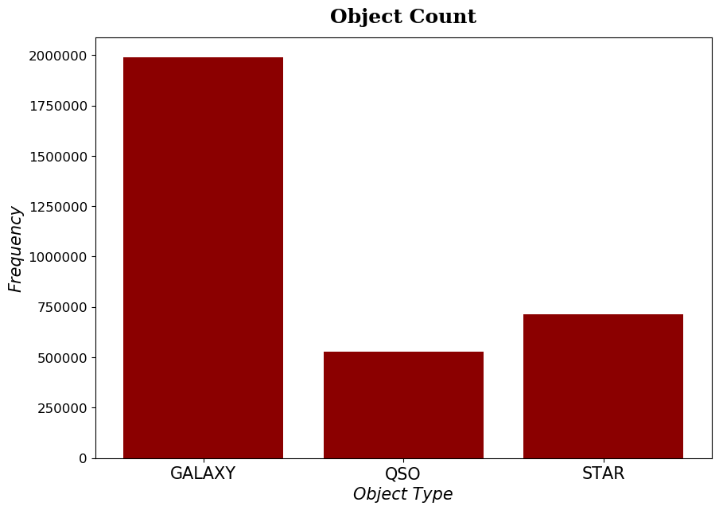
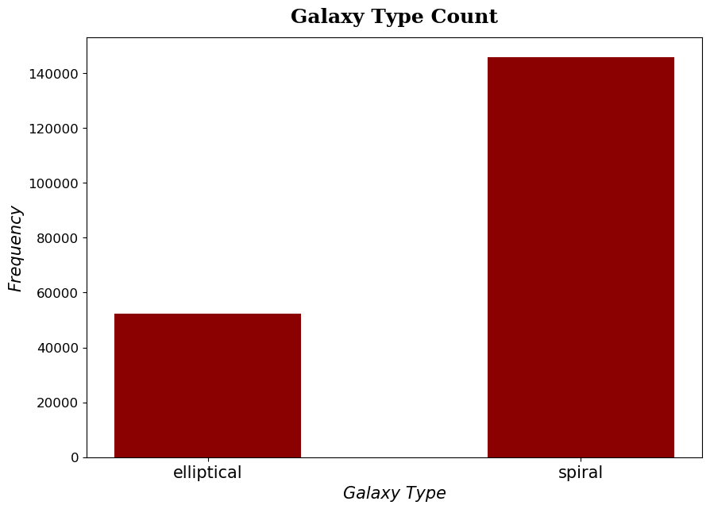
Managing Astronomical Proportions

Slide 5
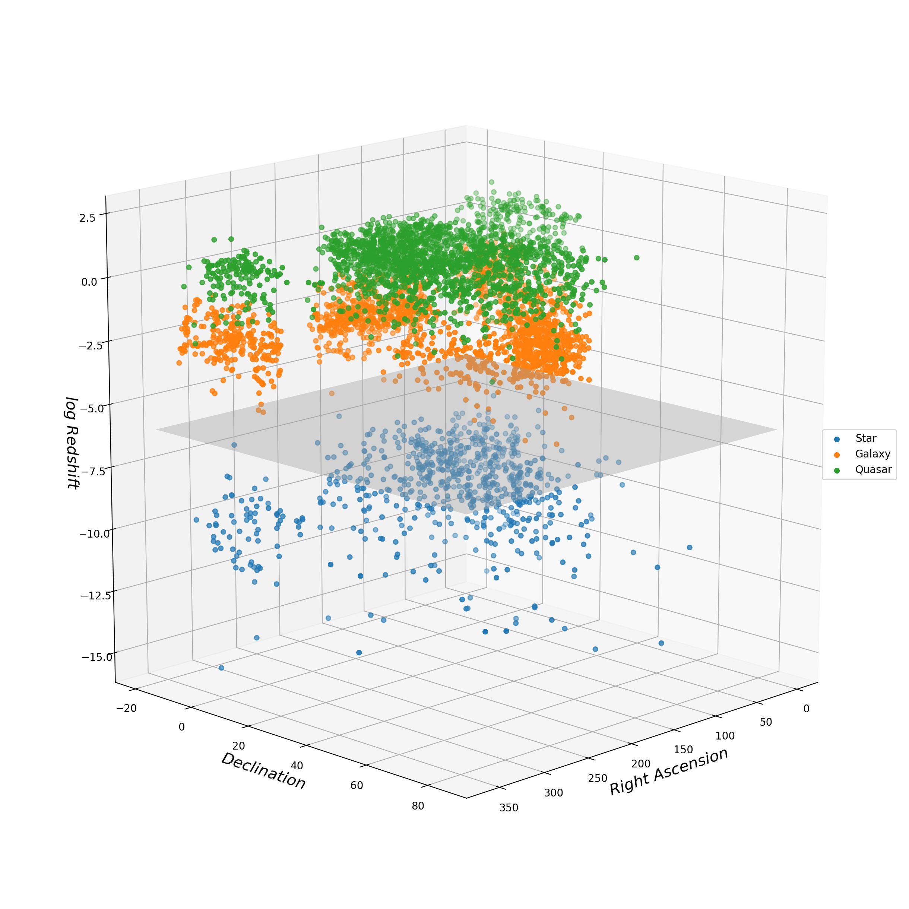
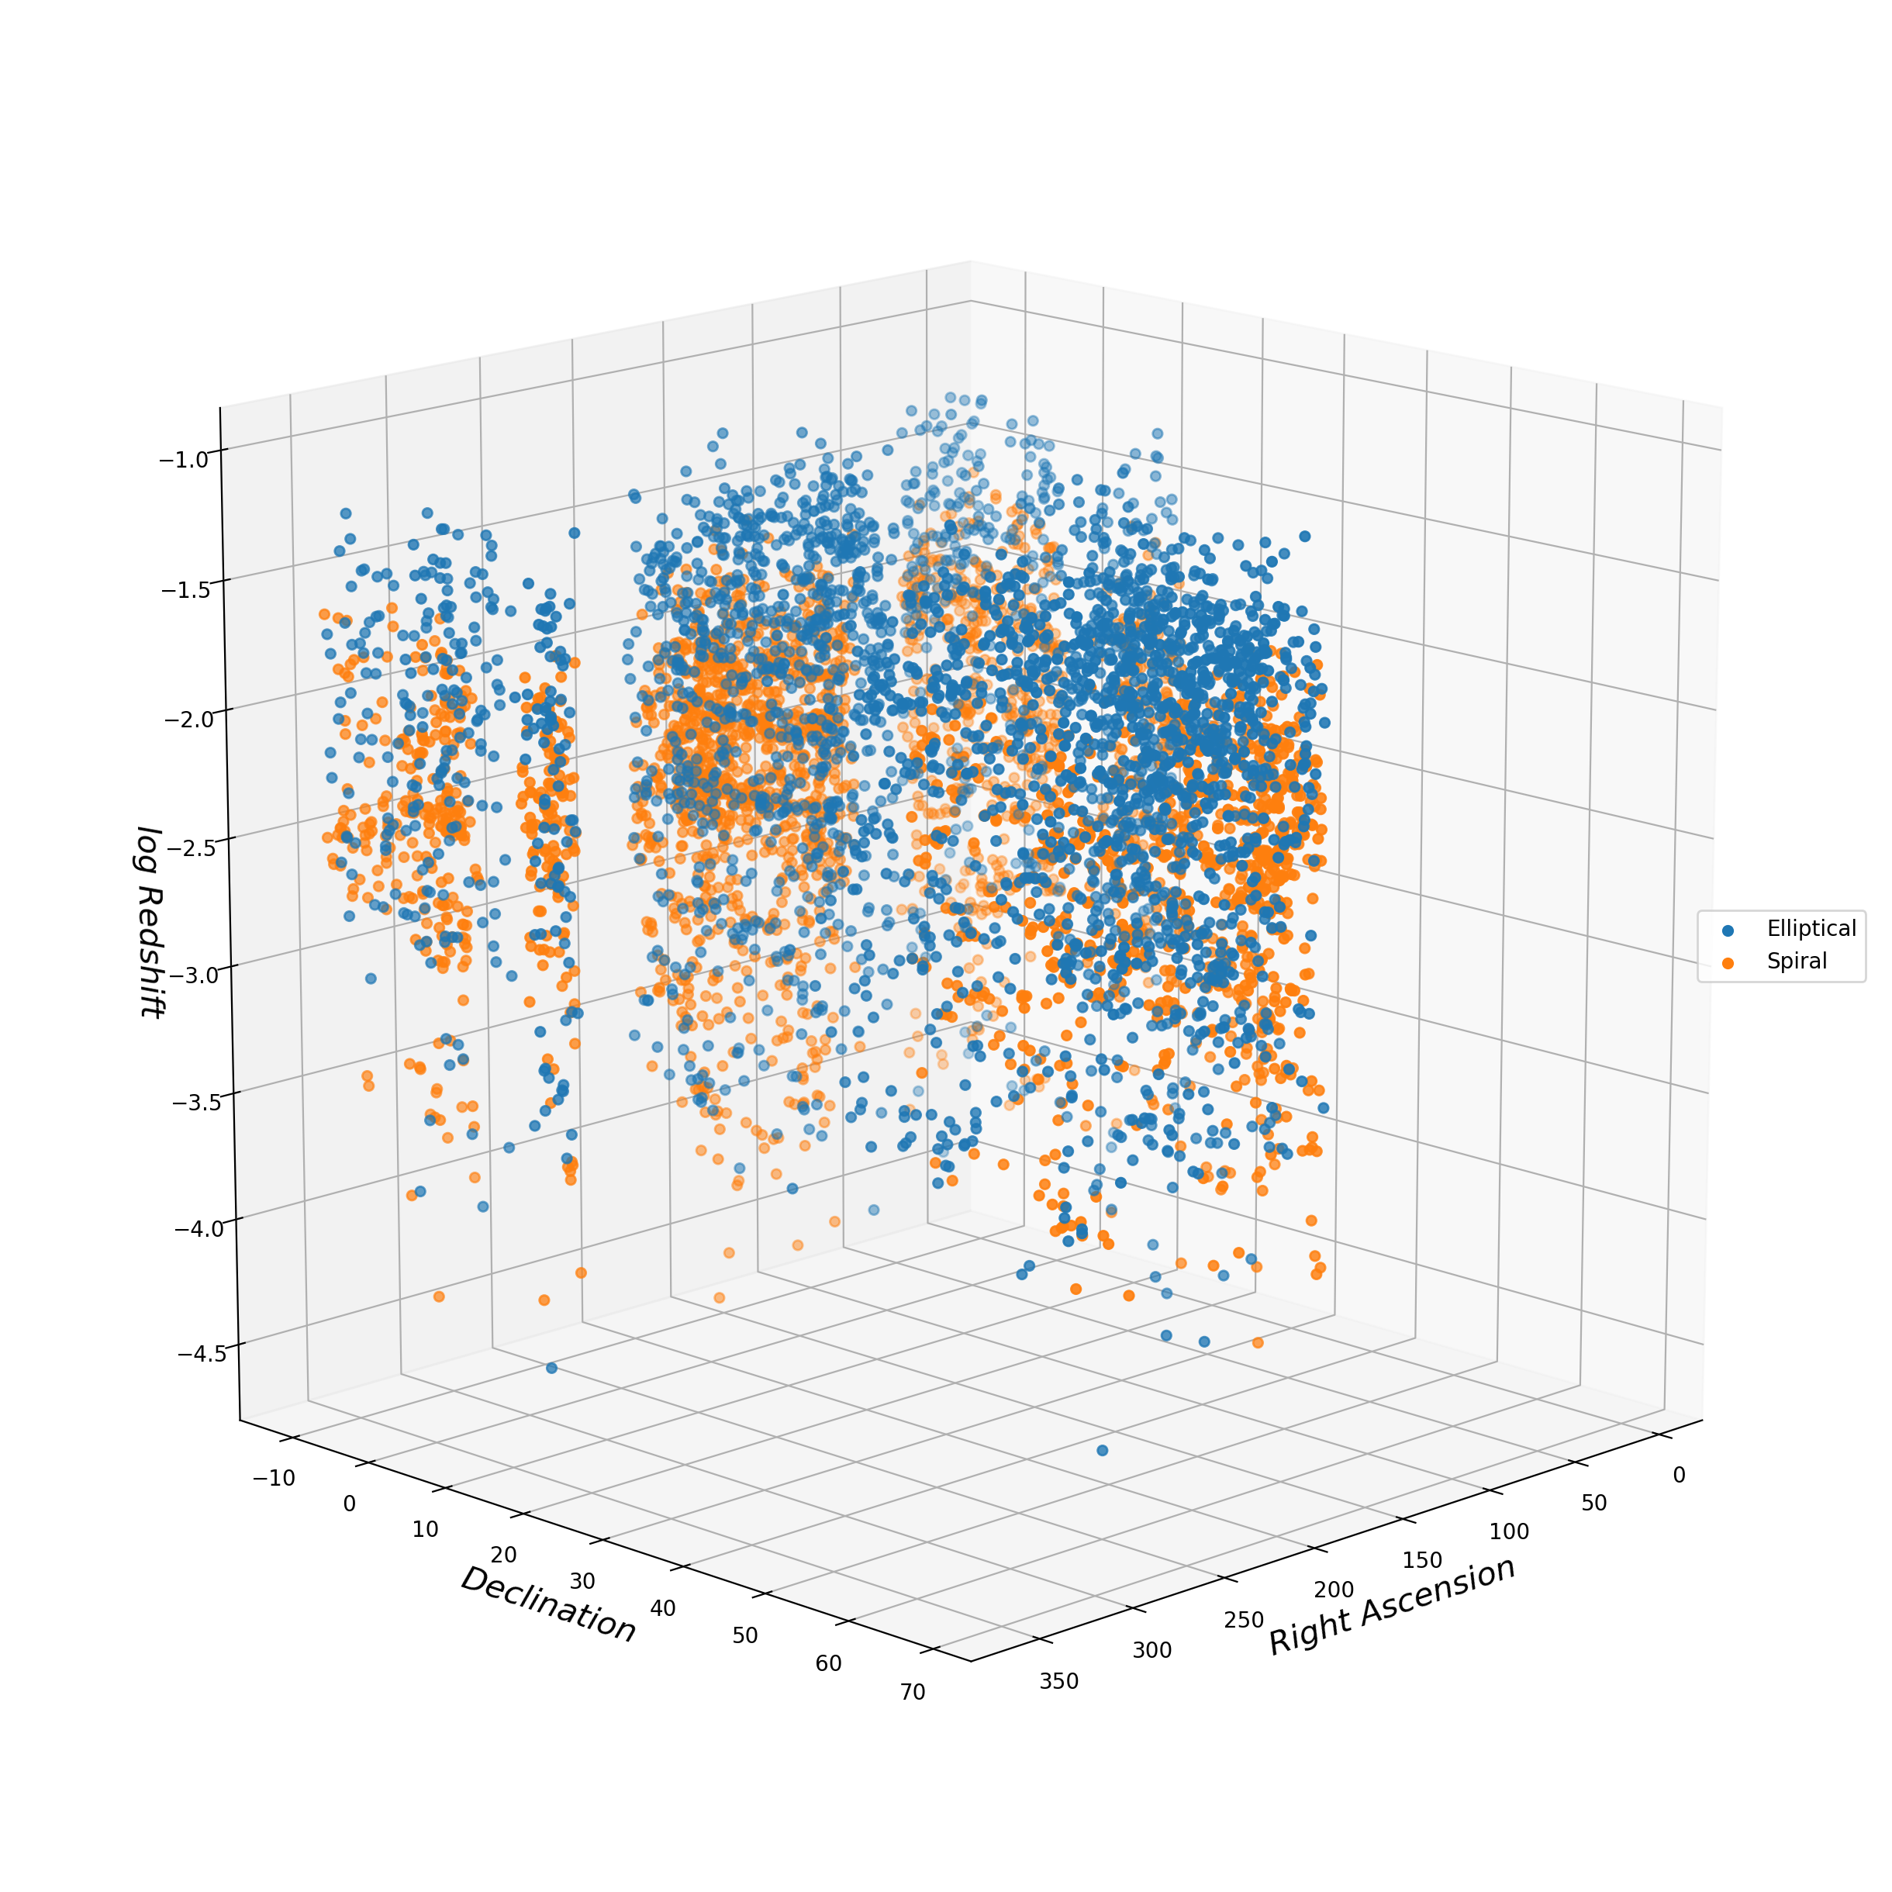
Redshift, Blueshift

Slide 6
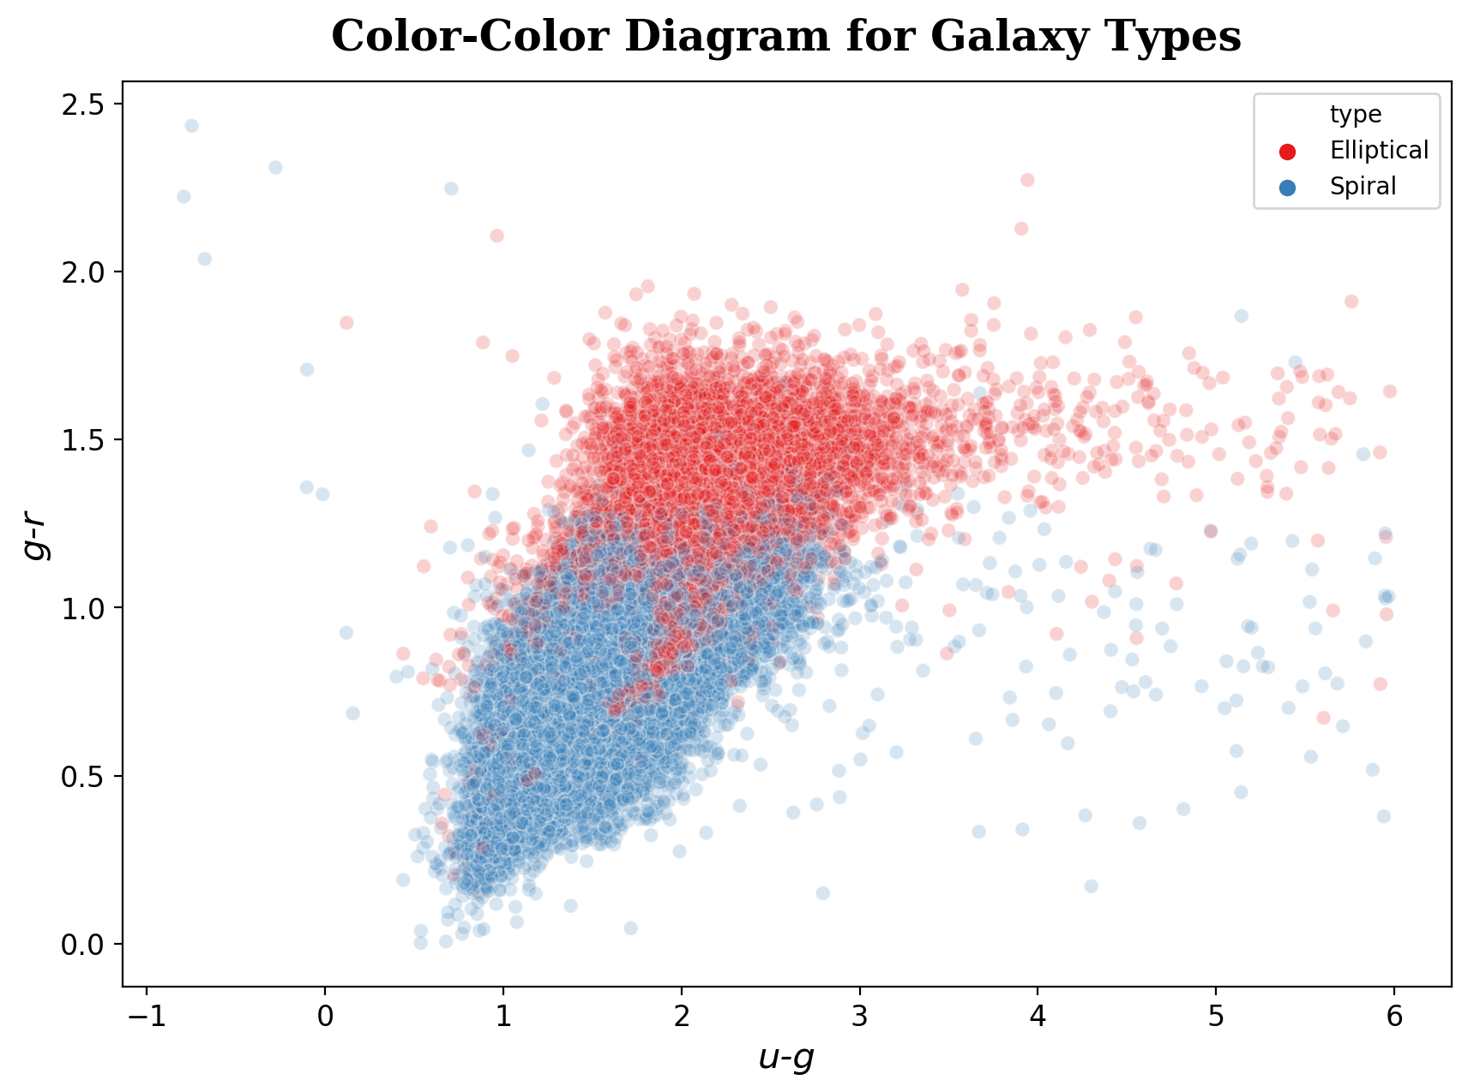

Slide 7
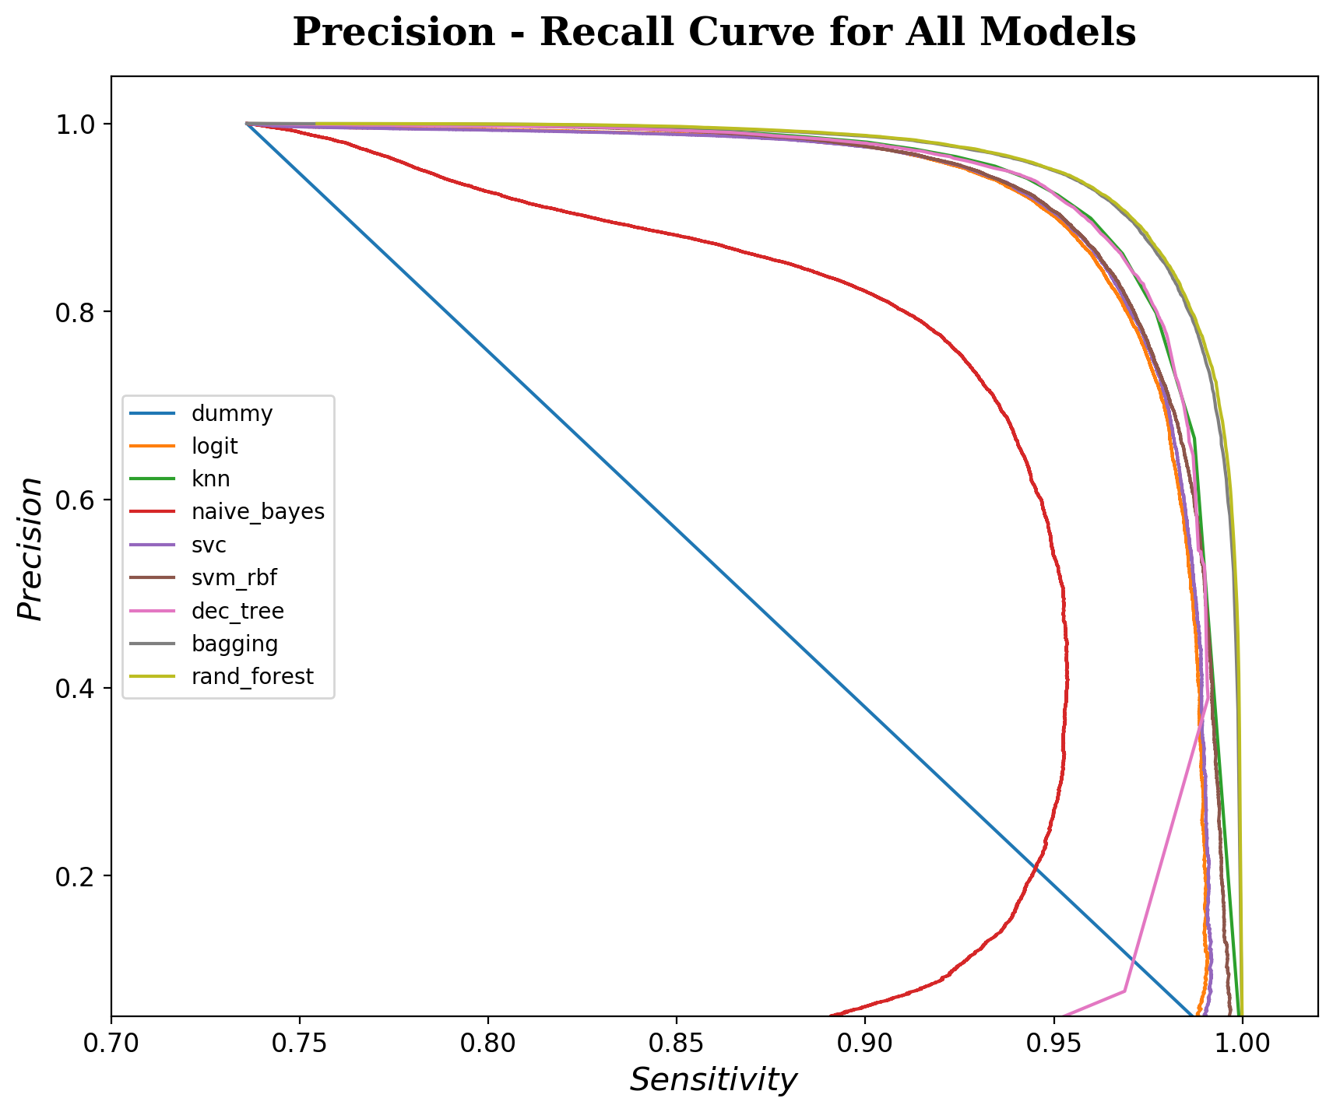
Nonlinear Models Performed Best Overall

Slide 8
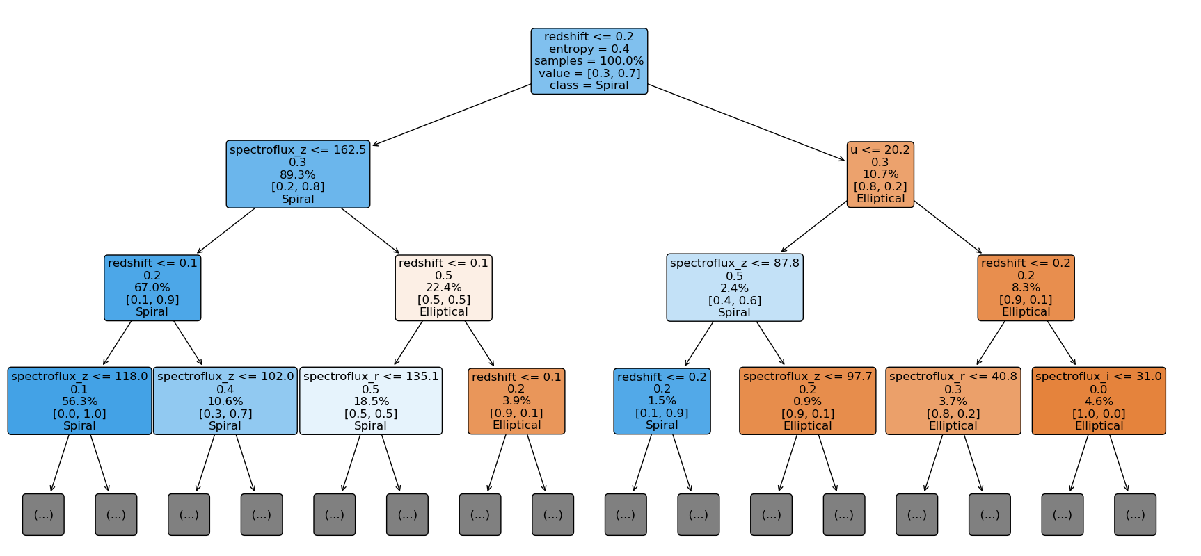
Early Splits Dominated by Redshift, Infrared

Slide 9
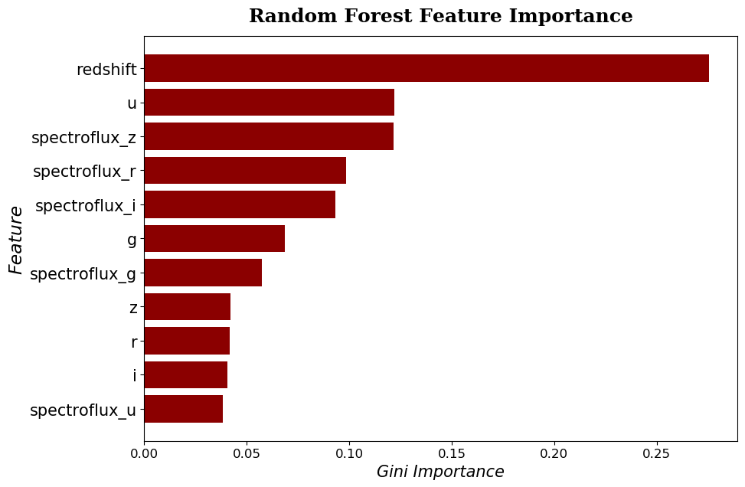

Slide 10
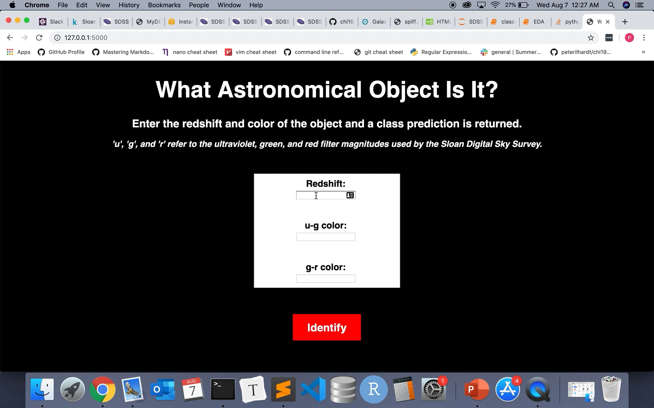
Predicting Unknown Objects

Slide 11
Appendix

Slide 12
Why Classify Space?
Understand the origins, history and fate of the universe
Provide insight into objects we cannot reach
Test fundamental scientific laws
Exploration, curiosity
Sloan Digital Sky Survey

